Slide 1
What’s New in IBM RPA 21.0.2 —
Notes:
Today we’re gonna cover the new features and updates of IBM RPA 21.0.2 release.
General Availability - OpenShift Platform: Dec 17th - On-Premise: Dec 21st - SaaS: late January I kindly ask to save your questions for the end of the presentation.

Slide 2
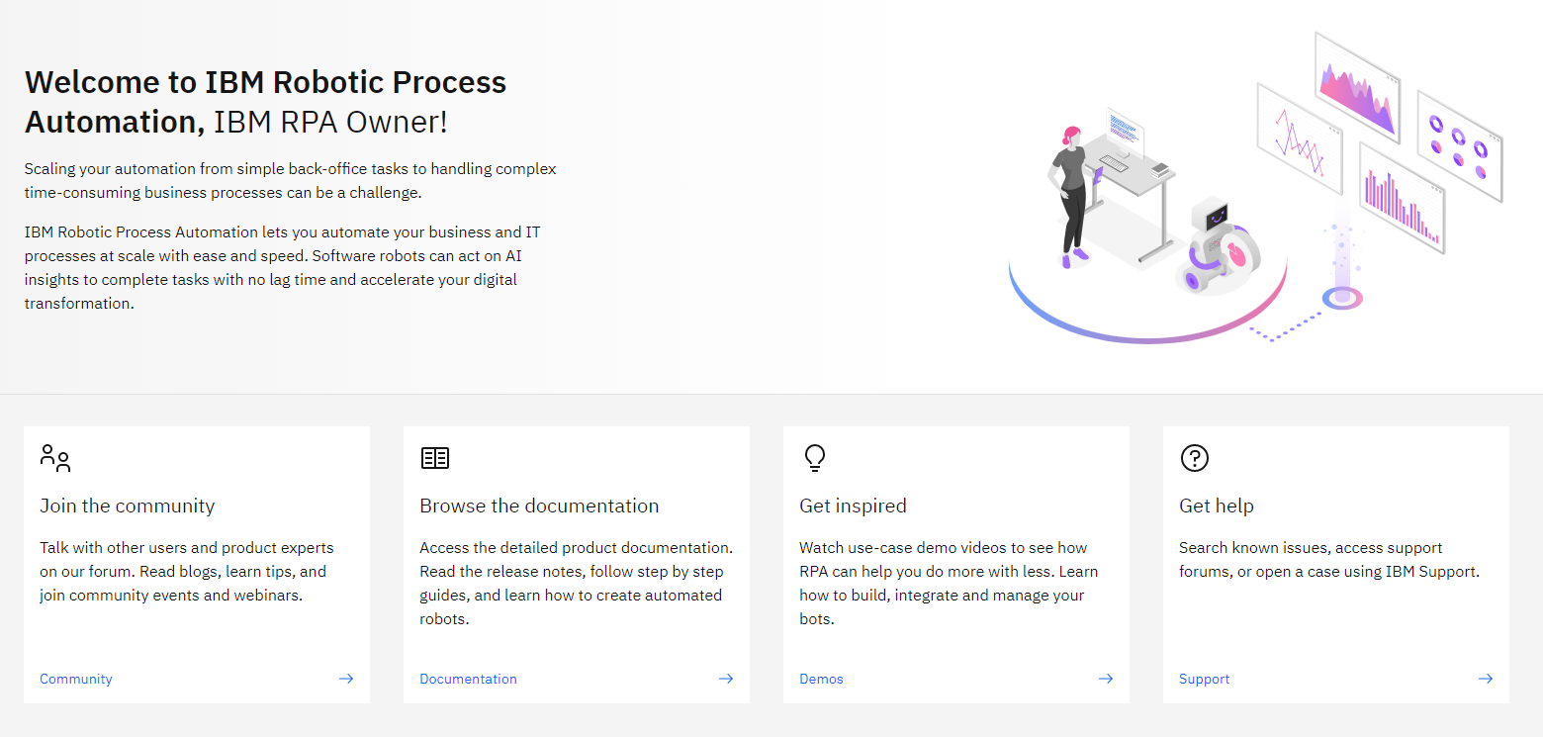
New home experience
IBM Business Automation / What’s New in IBM RPA 21.0.2 / Dec 20, 2021 / © 2021 IBM Corporation
Notes:
Welcome to the new home experience. The new home experience is the 1st step to provide more information for platform users. This experience will be enhanced in future releases to display insighful data tailored for each type of role in the organization. Further improvements will follow to allow users to take actions right from “Home” ☺

Slide 3
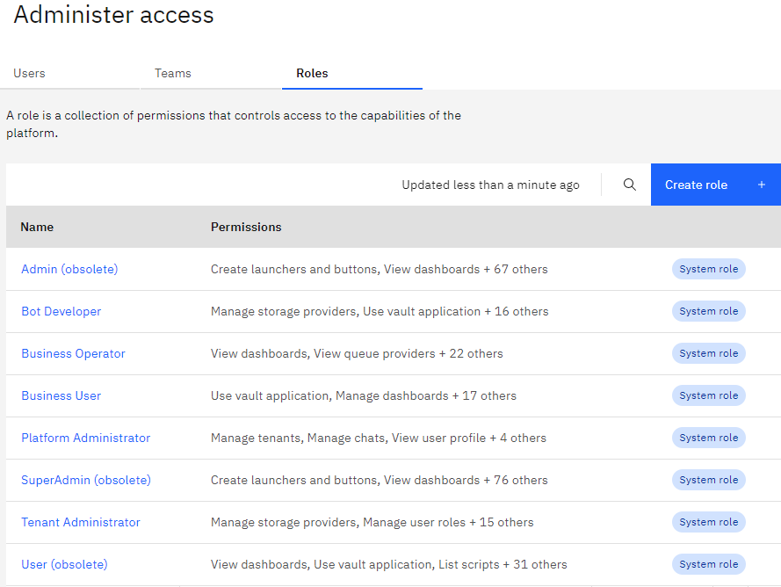
Roles for everyday business RBAC
Platform Administrator
Responsible to manage and maintain the platform configurations.
Tenant Administrator
Responsible to manage Tenant configurations and access.
Bot Developer
Responsible to architect and develop bots. Also have permission to manage dashboards.
Business Operator
Responsible to manage daily RPA operations, such as scheduling bots, monitor jobs, and assign computer policies.
Business User
Consumers of created bots to augment their work. They are also responsible to configure their own vault credentials.
IBM Business Automation / What’s New in IBM RPA 21.0.2 / Dec 20, 2021 / © 2021 IBM Corporation
Notes:
We’re enhancing our previously limited support for roles, by introducing Role Base Access Control (RBAC) designed based on the NIST 359 - 2012 model standard. IBM RPA roles restrict access to modules. Modules are type of resources, like Scripts, Computers, Dashboards. Therefore, you will be able to restrict access to every type of module in the platform. This is the first step to introduce access control on the resources themselves. Resources are instances of module types, for example, the Script named “MyAutomation” is a resource of the “script” module type. Further enhancements planned for future releases will add the capability to restrict access to a group of resources. There will be 5 default roles: - Platform Administrator (read responsibility) - Tenant Administrator (read responsibility) - Bot Developer (read responsibility) - Business Operator (read responsibility) - Business User (read responsibility) These roles were careful thought and cannot be changed or deleted. However, you can use them as a template to create new custom roles, as we will see in the next slide. It’s also worth mentioning that we might add new roles in future releases based on customer feedback and design research.

Slide 4
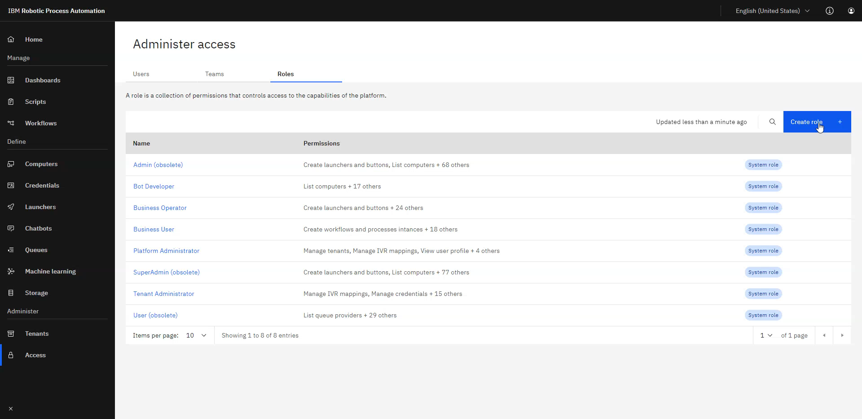
You are in control Custom roles
IBM Business Automation / What’s New in IBM RPA 21.0.2 / Dec 20, 2021 / © 2021 IBM Corporation
Notes:
In addition to the 5 default roles, we’re enabling customers to create their own roles. This will provide the flexibility without losing security. Moreover, you can use the default roles as a starting point. In the video, you can see how easy it is to create and delete roles. The permission list shows a good description of what responsibilities that permission entails. You can always review the permissions in the role detail page as well. You can also review which users and teams have the role assigned to them.

Slide 5
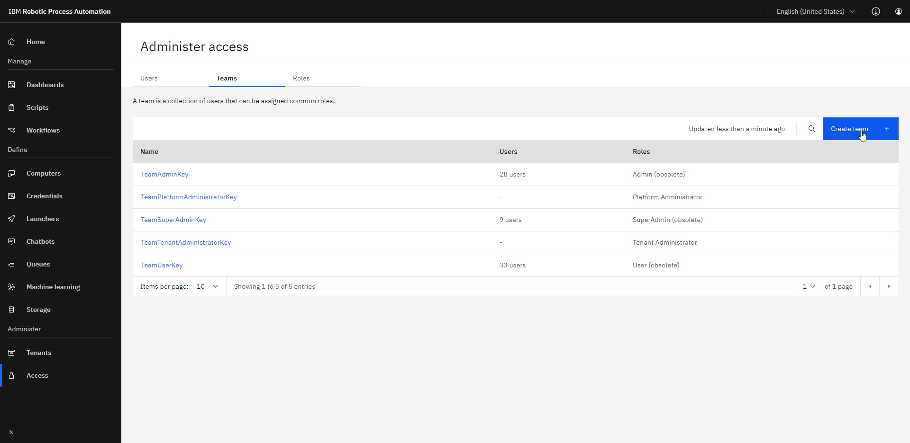
Manage your teams
Notes:
We’re introducing Teams.
As you can see in the video, you now have the ability to create teams and assign roles to them. We want customers to follow the best practices when defining access control. So, our guideline is to create a role and a team along with the role. Assign the role to the team, and add people to the team, instead of adding individual roles to people. That way, whenever a person is added to the team, they automatically inherit team roles.

Slide 6
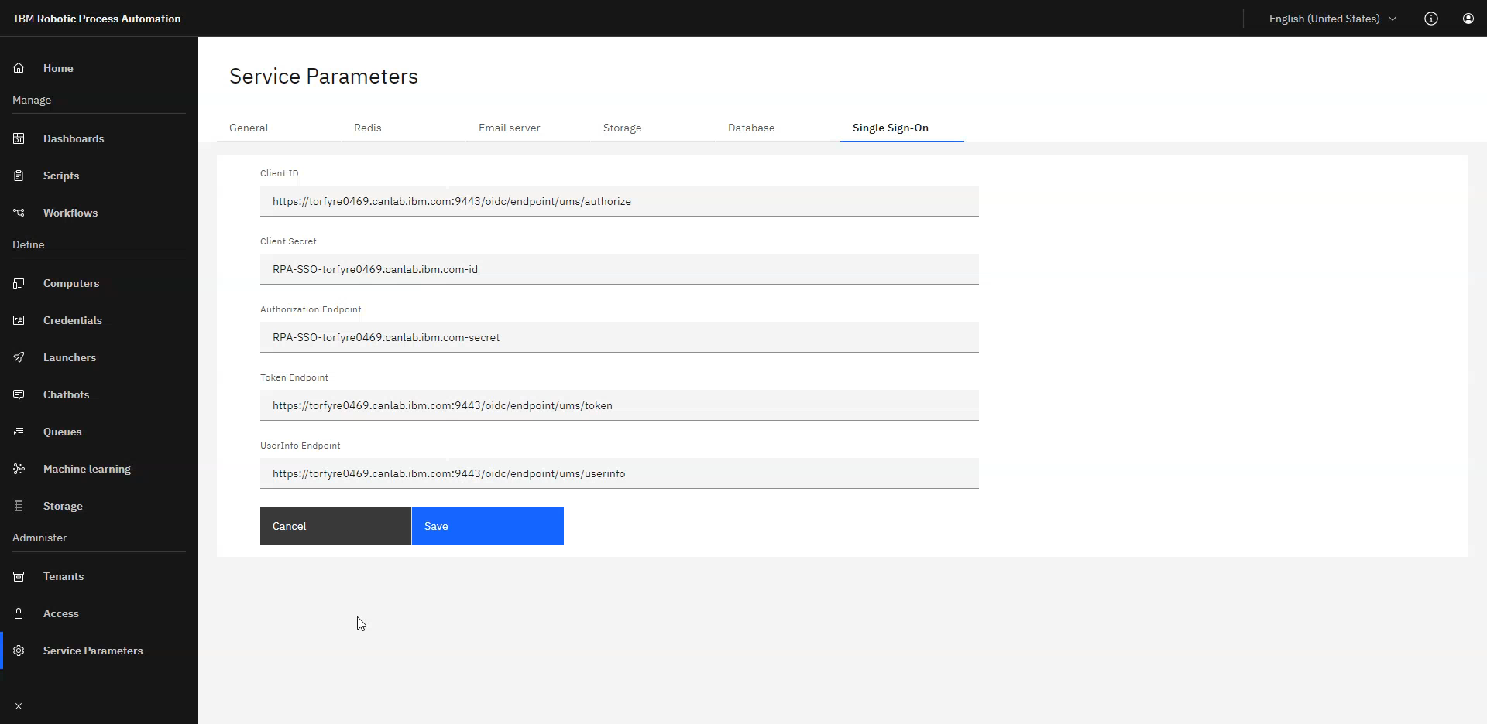
Integrate with your Activity Directory through LDAP support
Notes:
IBM RPA On-Prem is now packaged with User Management Service (UMS), which provides support for OpenID Connect Provider (OIDC) and System for Cross-domain Identity Management (SCIM). The UMS provides the capability to connect to LDAP servers. With this new component, customers will be able to configure LDAP support for IBM RPA On-Prem. For IBM RPA on OpenShift, there’s no additional configuration needed. The operator configures it automatically.

Slide 7
Seamless migration RBAC
Role 21.0.1
Role 21.0.2
Team
Obsolete
User role
Obsolete
User role
User role
User team
John
Susan
Obsolete
Admin
Obsolete
Super admin
Notes:
Regardless of the deployment option (SaaS, On-Prem, OpenShift), the migration to the new model is automatic and seamless.
All the roles that we had in previous versions, “SuperAdmin”, “Admin”, “User” will be created as obsolete roles. [PLAY ANIMATION] Following the best practices mentioned before, the migration will create 3 teams (“SuperAdmin” team, “Admin” team, “User” team) [PLAY ANIMATION] Each of these teams will be assigned the correct role, for example, the “User” team will have the “User” obsolete role.
Then, every user will be added to the correct team, according to their previous roles in the old model. [PLAY ANIMATION]
In addition to the obsolete teams, there will be also 2 teams created: Platform Administrator team and Tenant Administrator team.
With this migration, everything will seem the same. The “admin” will be able to do everything he was able to do previously, and so the other roles. We encourage customers to migrate people to the correct teams and gradually stop using the obsolete roles.
Of course, for brand new deployments, the obsolete roles and respective teams will not be created.

Slide 8

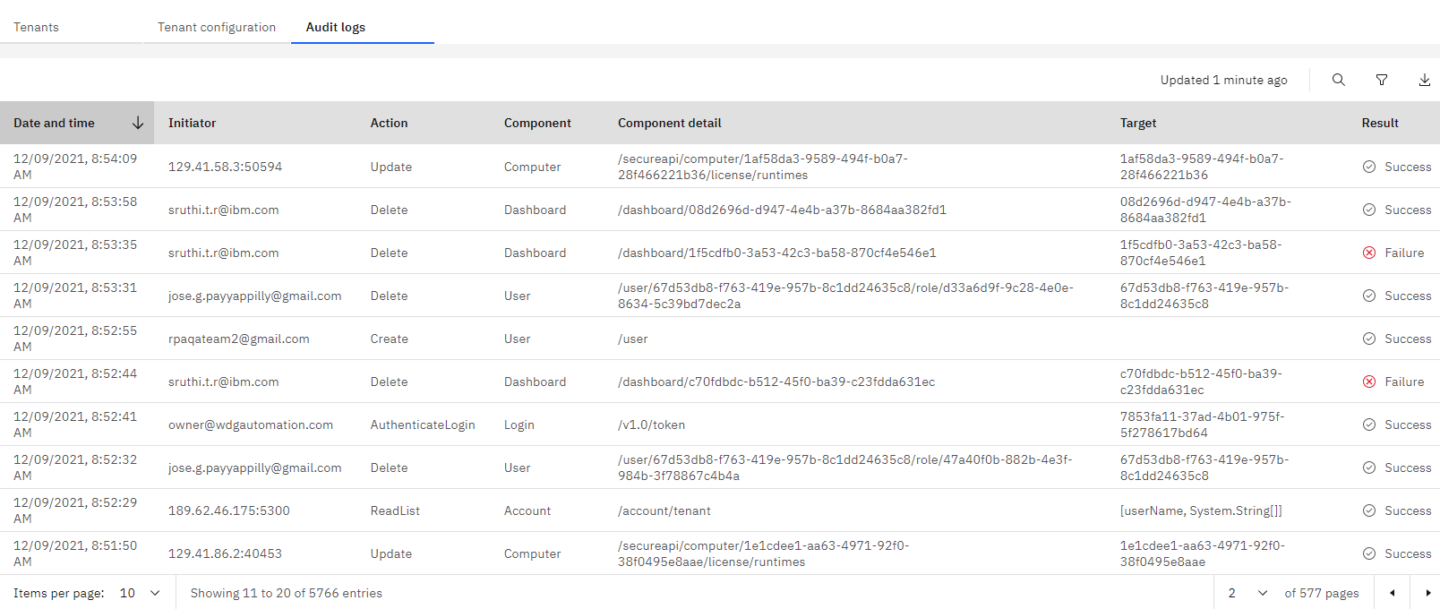

When
Who
What
Where
Everything is audited
Success attempts
Failed attempts
Filter by anything
Export to spreadsheet
CADF compliant
Notes:
By default, everything is audited, even READ requests. For example, if somebody navigate to the scripts page, IBM RPA will audit a “read” action to the “scripts” component. Tenant Administrators will have the option to disable “read requests” in the Tenant Configuration section. Also by default, the audit logs are saved both on Database and Files. For On-Prem deployments, Platform Administrators will have the option to disable Database storage. The generated logs follow the “Cloud Auditing Data Federation” (CADF) specification. Which means the IBM RPA audit logs are consumable by any “Security information and event management” (SIEM), like Splunk, LogDNA, and IBM QRadar.

Slide 9

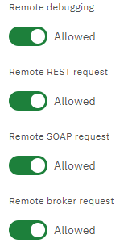
Governance with policies
Tenant policies
Reach compliance by applying governance to Tenants. The first feature to leverage this are computers.
Computer policies
Tweak availability to the local Bot Agent APIs: REST, SOAP, Broker.
Disable remote debugging.
IBM AND BUSINESS PARTNER USE ONLY
IBM Business Automation / What’s New in IBM RPA 21.0.2 / Dec 20, 2021 / © 2021 IBM Corporation
Notes:
We’re introducing Tenant policies in this release. Policies will strengthen the governance of the RPA platform. Starting with Computer Policies, Tenant Administrators will have the ability to disable the local Bot Agent APIs, known as by their ports: 8099, 8098, and 8096. Remote debugging is also a policy, which will enable organizations to completely disable this functionality.
In future releases, we’re planning to expand the reach of policies in several aspects of the platform, such as Vault and Studio configurations. We’re also planning to make policies more granular to Groups, Projects, and Environments.

Slide 10


Enhance security of keys
Read more technical details in the documentation
The following three features greatly enhance the governance and protection of keys within IBM RPA.
Support for passphrase protected private keys
Restrict runtime access to the private key
Over-the-wire protection
Notes:
Support for passphrase Private keys files such as PEM or PKCS support passphrases, so do IBM RPA new version! Now you can use password protected private keys when configuring tenant credentials. Restrict runtime access to the private key I’m going to mention “runtime”, so let’s quickly define it: the IBM RPA runtime is responsible to run scripts in a sandbox environment. It is controlled by the Bot Agent, which spawns new runtimes whenever it needs to run bots. The runtime always runs under a Windows User account. So, in previous versions, the IBM RPA runtime had access to the private key to decrypt vault credentials, which means the Windows User account also had access to the private key. With this new version, only the Bot Agent, which runs under a privileged Windows account, access the private key to decrypt vault credentials. This change allows customers to restrict access to the private key using the default Windows policies, only enabling privileged users such as Local System to access it. Over-the-wire protection All credentials already travel encrypted over-the-wire and only get decrypted in the Bot Agent. This is highly secure, but if some unwanted party had access to the private key, they can decrypt the message. But with the new version they won’t be able to. We’re introducing a new technique using an One-Time-Public-Key (OTPB) for each credential request. Which means, only the instance of the Bot Agent that requested the credential will be able to decrypt it, because it’s the only instance that holds the One-Time-Private-Key.

Slide 11
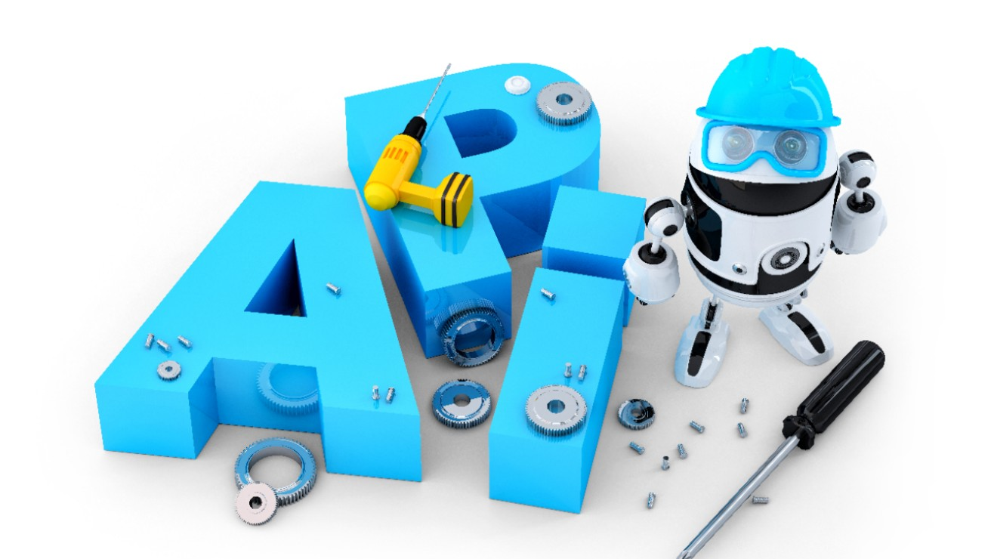
Start bot from API
Secure, auditable, asynchronous API available on the Server.
Create a process with only one step
Get script input schema
Where will the bot run?
Since we’re using processes, the orchestrator will manage where the bot will be executed based on the only one step computers configuration.
Advantages
By using this feature to trigger bots, you instantly gain scalability, high availability, and intelligent workload.
Create a process instance
Check instance status
IBM Business Automation / What’s New in IBM RPA 21.0.2 / Dec 20, 2021 / © 2021 IBM Corporation
Notes:
The IBM RPA orchestration process is a powerful feature that enables managing intelligently workloads of bot executions. We’re introducing new public APIs that allows integrators to leverage the orchestration process to execute bots by making a POST request directly on the Server, passing bot input parameters, and retrieving bot output values. In order to do that, you need to create a Process with only 1 step. Processes with only 1 step have only 1 script attached. Therefore, when you get process details through the API, you will receive the input and output schema parameters of the script. You can then use the schema to pass the correct payload when you create a process instance. You can then use the “check instance status” API to retrieve the bot outputs when the status is “done”. This feature is very powerful and can be used by different products to integrate with IBM RPA. For instance, IBM App Connect will leverage this feature to create the RPA connector.

Slide 12
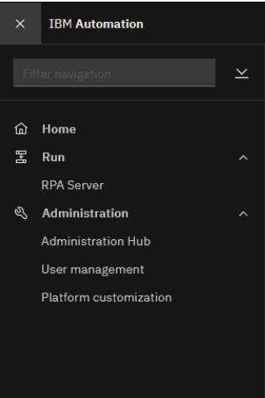
Access RPA using the Automation Platform RPA on OpenShift
RPA is better integrated within the Automation Platform providing a consistent user experience
RPA now uses the same route as the Automation Platform, which
Simplifies configuration
Improves certificate management
Enhances performance for single-sign-on
Notes:
RPA is better integrated within the Automation Platform providing a consistent user experience
RPA now uses the same route as the Automation Platform, which simplifies configuration and certificate management, and improves performance for SSO

Slide 13
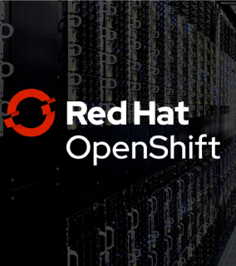
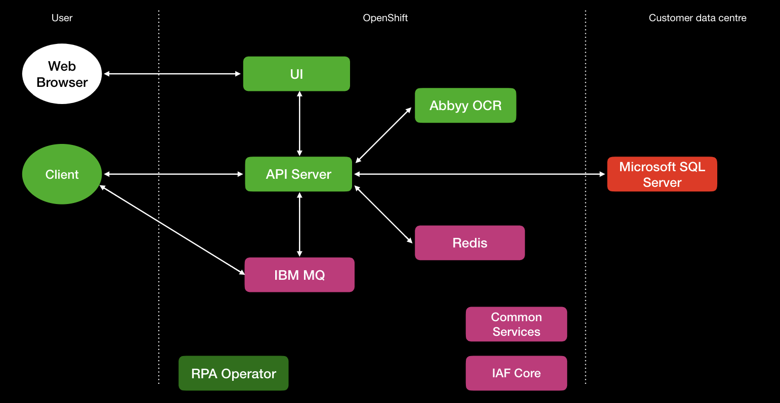
High Availability RPA on OpenShift
A high availability configuration contains multiple replicas of each RPA component: UI, API, OCR, and Antivirus
IBM MQ used for the RPA system queue provider can also be configured for high availability
Antivirus
Notes:
Configuring your RPA Custom Resource (CR) for high availability
You can configure the IBM RPA operator for high availability if you want to provide a more stable platform for RPA that can still run with minor infrastructure failures.
A high availability configuration contains multiple replicas of each component of RPA. Therefore, if one replica fails, Red Hat OpenShift routes work to another replica. Red Hat OpenShift restarts failed pods to restore highly available configuration.
To configure HA, you can customize the number of replicas for each component in the CR. Most deployments would not need anymore then two replicas. By default, each component has only one replica. For a complete high availability configuration, you need more than one replica in the CR.
The RPA operator deploys an instance of IBM MQ as the system queue provider. For a high availability configuration for IBM MQ, specify highAvailability: true in the CR under systemQueueProvider.

Slide 14
Improved Abbyy OCR support
Idea
WDGRPA-I-64
Abbyy is one the majors vendors for Optical Character Recognition (OCR).
Abbyy support for the following components are improved:
Click by OCR
Get PDF Text by OCR
Extract PDF Text tool
Notes:
We improved Abbyy support for 2 OCR commands. We also improved support in the Extract PDF Text tool available on Studio.

Slide 15
Bring your own Redis
On-Premise
Redis is used to store server state in a distributed and highly efficient manner.
Redis is not packaged with the installer anymore
Redis is optional for simple deployments
Note: for high-availability, Redis is required
Notes:
In previous versions, IBM RPA Server installer for On-Premise deployments was bundled with a Redis version targeting Windows Operating System. That version is no longer supported by Microsoft. We removed the Redis from the install package. If customers want to install Redis, they need to bring their own. However, Redis is optional, therefore there’s no impact in the provisioning of IBM RPA Server. Redis being optional is good for simple deployments. But, bear in mind that to achieve High-Availability, a Redis instance is required.

Slide 16

Next steps
Dig deeper
Explore in detail what’s new in IBM RPA 21.0.2.
Release notes
Explore the documentation
Have you seen these recently updated topics?
Script development
Deploying bots
Orchestrating bots
Training
Automating tasks with IBM Robotic Process Automation
Take the course
IBM Business Automation / What’s New in IBM RPA 21.0.2 / Dec 20, 2021 / © 2021 IBM Corporation
Notes:
Where to go from here? If you haven’t yet, download the latest version. You can explore in more detail the release notes. Explore new documentations. Take the new course.
Links:
Release notes: https://www.ibm.com/docs/en/rpa/21.0?topic=release-notes
Script development: https://www.ibm.com/docs/en/rpa/21.0?topic=automation-script-development
Deploying bots: https://www.ibm.com/docs/en/rpa/21.0?topic=automation-deploying-bots
Orchestrating bots: https://www.ibm.com/docs/en/rpa/21.0?topic=automation-orchestrating-bots
Course: https://www.ibm.com/training/course/WB504G

Slide 17
Thank you
Joberto Diniz
Product Manager, IBM Business Automation
—
joberto.diniz@ibm.com
ibm.com
© Copyright IBM Corporation 2019. All rights reserved. The information contained in these materials is provided for informational purposes only, and is provided AS IS without warranty of any kind, express or implied. Any statement of direction represents IBM’s current intent, is subject to change or withdrawal, and represent only goals and objectives. IBM, the IBM logo, and ibm.com are trademarks of IBM Corp., registered in many jurisdictions worldwide. Other product and service names might be trademarks of IBM or other companies. A current list of IBM trademarks is available at Copyright and trademark information.

Slide 18
IBM sign-off

